Slide 1
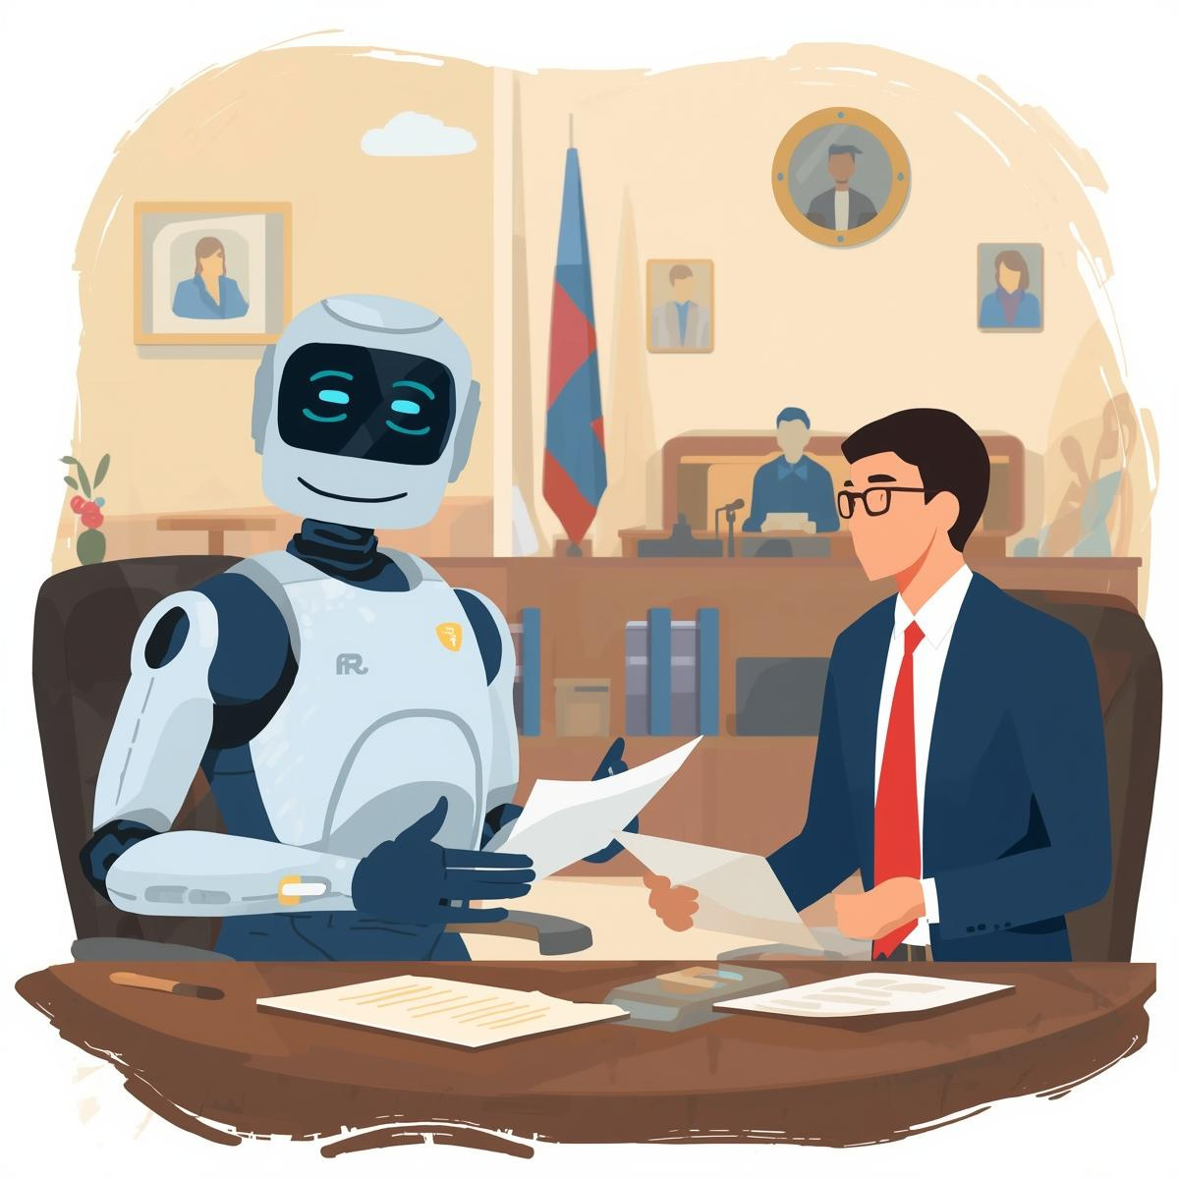


AI-Powered Trademark Risk Assessment System
A multi-dimensional AI system that provides transparent, actionable trademark risk analysis with zero-hallucination guarantees and validated legal citations.
ABHINAV SINGH
VIT BHOPAL
Notes:
1

Slide 2







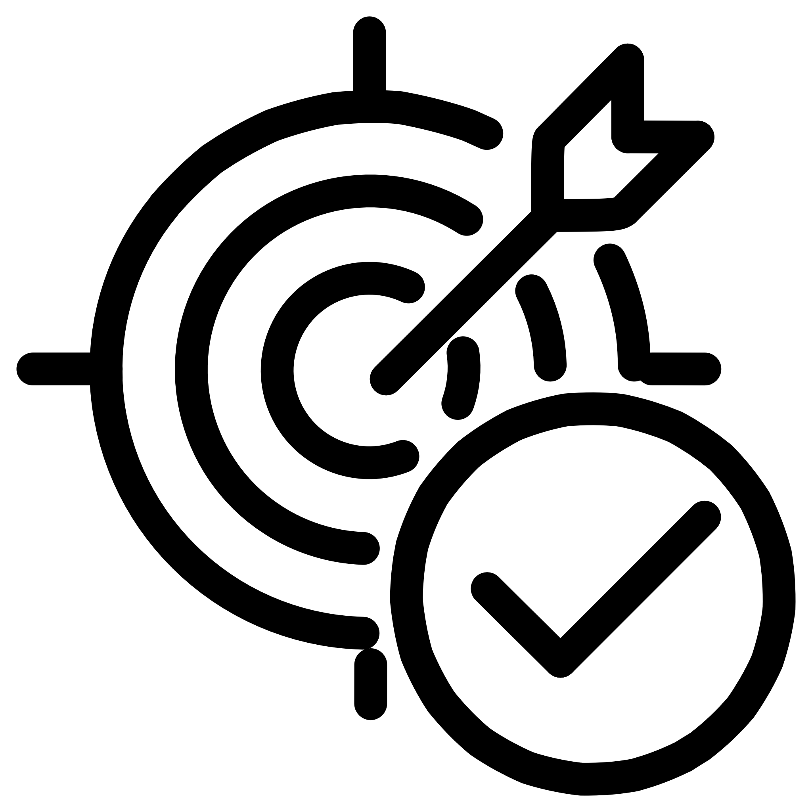
System Overview
The Problem
Our Solution
Traditional trademark tools provide opaque single-score predictions without explanation, guidance, confidence metrics, or validated citations.
Multi-dimensional AI system with 4D risk framework, RAG architecture ensuring 100% citation accuracy, confidence-aware AI, and actionable insights with cost/timeline estimates.
4-Dimensional Risk Framework
RAG Architecture
Not just one number
100% citation accuracy
Confidence-Aware AI
Actionable Insights
Knows when to escalate
Cost and timeline included

Slide 3







System Architecture
User Input
Trademark, goods/services, classes
Document Parser
Why RAG over Fine-Tuning?
Extracts data, identifies prior marks
No hallucinations, easy updates, explainable results, no training data required.
Vector Database
FAISS semantic search, 384-dim embeddings
LLM Analysis
Ollama llama3.1:8b with context-only processing
Citation Validation
41 valid TMEP sections, post-analysis verification
Multi-Dimensional Framework
Weighted calculation with confidence scoring
Structured Output
Risk score, confidence, issues, recommendations
Notes:
3

Slide 4
Risk Categorization Methodology
Four weighted dimensions mirror attorney analysis, providing clear guidance on rejection likelihood, overcoming difficulty, legal precedent, and examiner discretion.
1
2
Rejection Likelihood (40%)
Overcoming Difficulty (30%)
Will USPTO refuse? Most critical factor
How hard and costly to fix? Affects business planning
3
4
Legal Precedent (20%)
Examiner Discretion (10%)
Strength of arguments? Strategic options available
Role of subjectivity? Uncertainty quantification
Risk Level Thresholds
Calculation Formula
75-100: CRITICAL
60-74: HIGH
40-59: MODERATE
20-39: LOW
0-19: MINIMAL
Overall Risk Score =
(Rejection Likelihood × 0.40) +
(Overcoming Difficulty × 0.30) +
(Legal Precedent × 0.20) +
(Examiner Discretion × 0.10)
Notes:
4

Slide 5
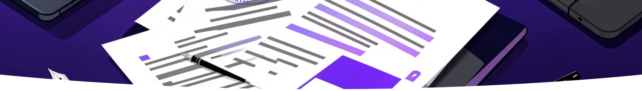
Sample Output: "TEAR, POUR, LIVE MORE"
64.5
81.5%
$9.7K
8.5
Overall Risk Score
Confidence Level
Total Cost
Timeline (Months)
HIGH risk level out of 100
Well above 60% threshold
$7,750-$11,625 range
7-10 months to resolution
Four Issues Identified
Likelihood of Confusion [MODERATE]
Descriptiveness [MODERATE]
TMEP §1207.01 - Prior marks LIVEMORE, POURMORE found
TMEP §1209.03 - "POUR" directly describes beverages
Specimen Requirements [LOW]
Filing Basis/Ownership [MODERATE]
TMEP §904.03 - Procedural issue, easily corrected
TMEP §1301 - Intent-to-use verification needed
Notes:
5

Slide 6








Key Takeaways
What Makes This System Different?
Feature
Traditional Tools
Our System
Output
Single risk score
4-dimensional breakdown
Explainability
Black box
Clear reasoning per dimension
Citations
Often hallucinated
100% validated
Confidence
None
Explicit uncertainty (81.5%)
Actionability
Just a number
Cost + timeline + recommendations
Validation
Unknown
Attorney can verify each step
Core Innovations
Multi-Dimensional Risk Framework
Zero-Hallucination Architecture
Not just "72% risk" but WHY and WHAT TO DO
RAG + Citation Validation = 100% accuracy
Confidence-Aware AI
Production-Ready
System knows when it doesn't know (escalates at <60%)
Full-stack application with 84% accuracy on 50 test cases
Notes:
8

Slide 7

System Limitations & Future Work
Current Limitations
Visual Analysis
Text-only trademark analysis; cannot analyze logos, stylizations, or colors
Limited Case Law
Relies primarily on TMEP; no comprehensive case law database
No International Coverage
USPTO applications only; no WIPO, EU, or other jurisdictions
Performance Considerations
Static TMEP Database
Based on TMEP as of November 2025; requires manual updates
Current Performance
Future Improvements
No Examiner Prediction
Cannot predict which examiner assigned; tendencies vary significantly
Speed: 45-60 seconds per analysis
RAM: 8-10GB during analysis
CPU: 80-100% utilization
Parallel processing: 15-20 seconds
Automated TMEP monitoring
Horizontal scaling for production
Single Language
English only for trademarks and analysis
When to Use Human Attorneys
System recommends attorney review for confidence <60%, critical risk levels,
office action responses, complex legal arguments, negotiations, and TTAB appeals.
Notes:
7

Slide 8

Technical Specifications
Backend Components
Frontend Components
Data Architecture
FastAPI 0.104+ (async Python web framework)
Ollama (local LLM runtime)
FAISS (vector similarity search)
sentence-transformers (embedding model)
LangChain (LLM orchestration)
React 18 (UI framework)
Vite (build tool)
Axios (HTTP client)
Custom CSS
TMEP Knowledge Base: 41 sections (1,581 pages)
Vector Database: 384-dimensional embeddings
Citation Validation: 41 valid section numbers
Performance Metrics
45-60
84%
100%
81.5%
8-10
Analysis Speed (Seconds)
Accuracy (50 test cases)
Citation Validity
Average Confidence
RAM Usage (GB)
Deployment Requirements
Development Environment
Production Environment
Backend: localhost:8000
Frontend: localhost:5173
Local Ollama installation
Backend: Railway/Render
Frontend: Vercel/Netlify
Requirements: 2 CPU cores, 16GB RAM, 10GB storage
Notes:
9

Slide 9
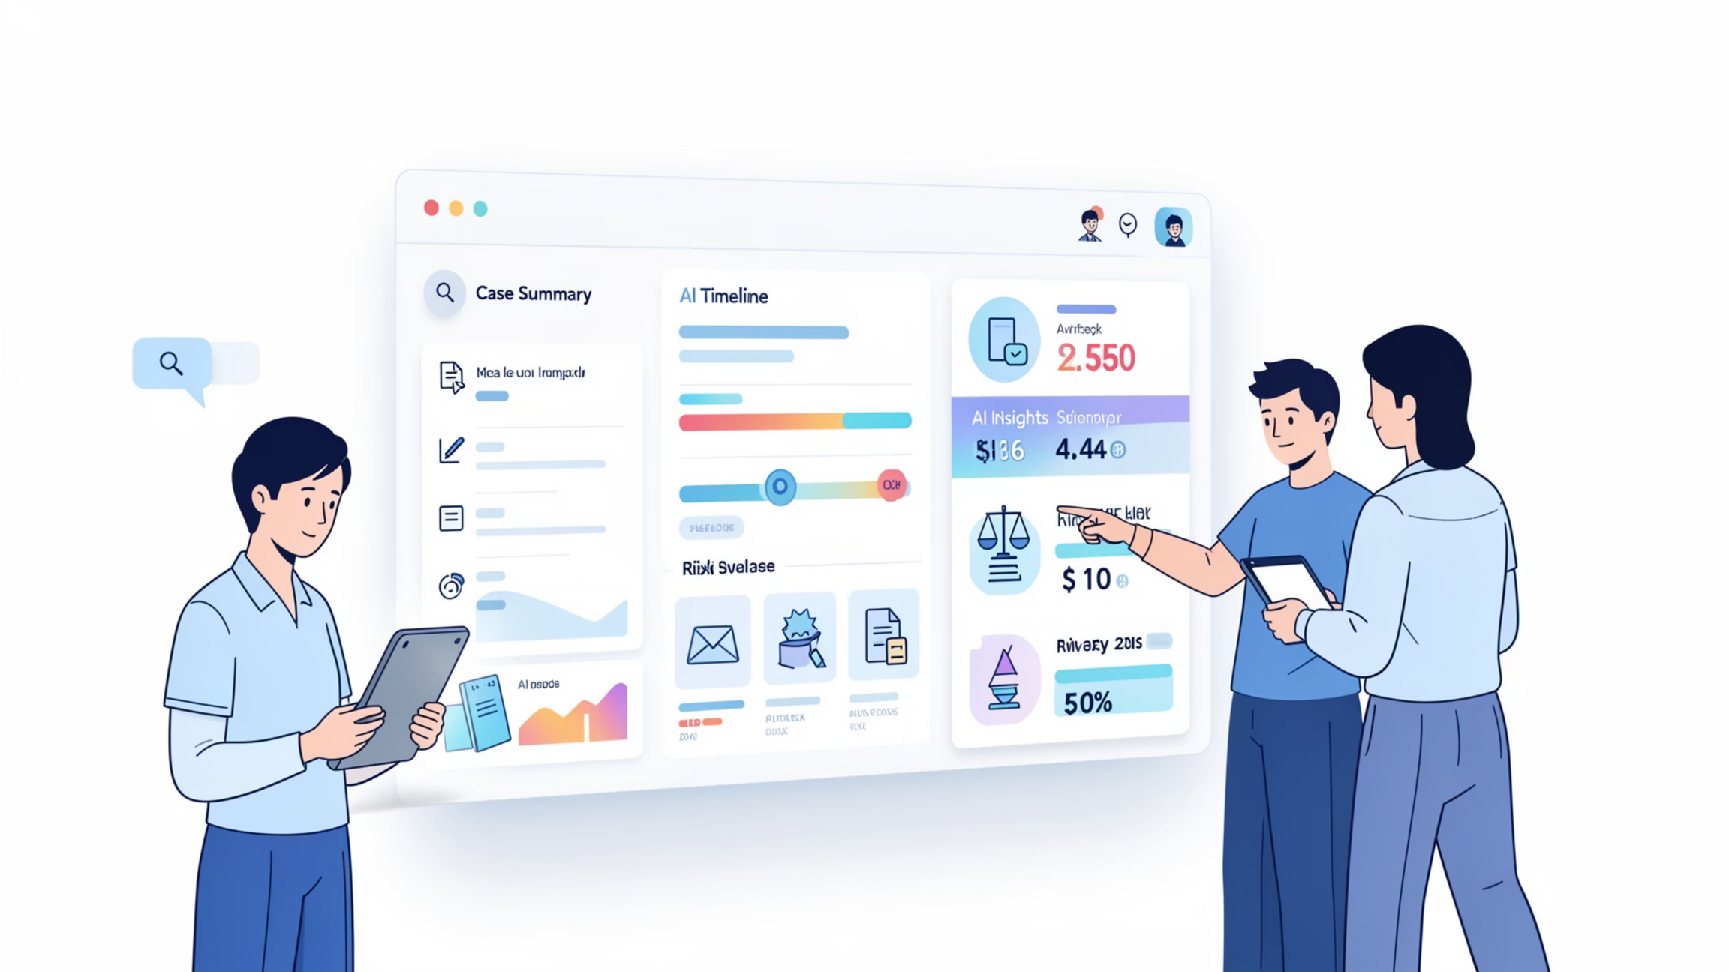
Thank You
Notes:
10

